Slide 1
OFDM Project
Presented by : Team 46
Submitted to: Dr. Mohamed Khairy Eng. Mohamed Khaled

Slide 2
Team Members & Roles
Name | ID | SEC | ROLE
احمد ابراهيم حسن ابراهيم | 9220014 | 1 | (Q3) OFDM
احمد خلف محمد على | 9220036 | 1 | (Q1) & (Q2) BPSK
احمد محمد إبراهيم | 9220078 | 1 | (Q2) QPSK & 16-QAM
Team : 46

Slide 3
Execution time of DFT and FFT

Slide 4
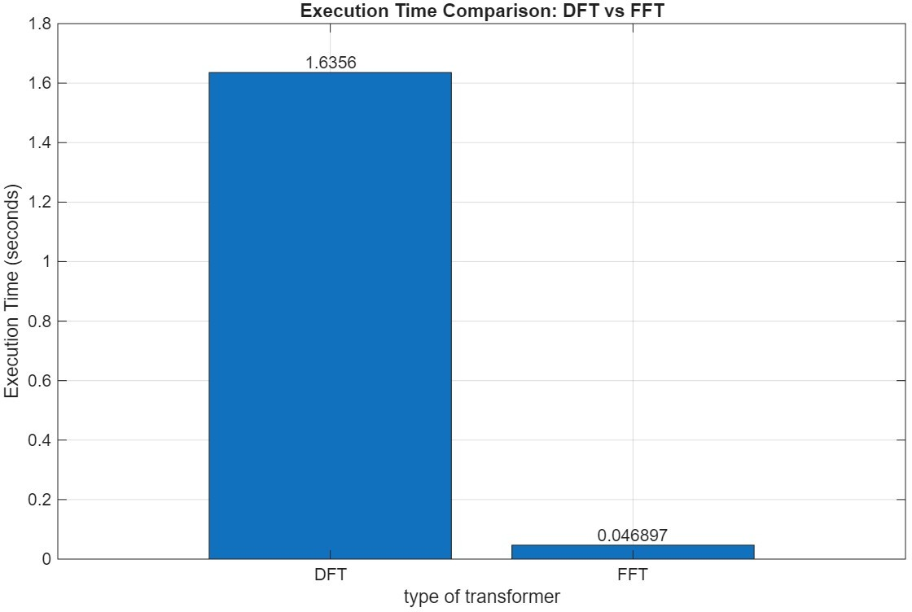
Execution time comparison
Execution time comparison
The FFT provides significantly superior performance compared to the direct DFT implementation in terms of execution time.
The FFT is the preferred method for computing the Fourier transform of large signals

Slide 5
Code
DFT Implementation:
function X_k = DFT_function(X_n) N=length(X_n); X_k=zeros(1,N); for k = 1:N-1 for n = 1:N-1 X_k(k+1) = X_k(k+1) + X_n(n+1) * exp((-1i*2*pi*n)/N); end end end
Test Signal Generation:
L= 4096; X_N = rand(1,L);

Slide 6
Code
Execution Time Measurement:
% count time taken for DFT tic; X_K_DFT= DFT_function(X_N); taken_time_DFT=toc; % count timw taken for fft tic; X_K_fft= fft(X_N); taken_time_fft=toc;
Result:
% print time taken for DFT and fft fprintf("DFT excution time : %.6f seconds\n",taken_time_DFT); fprintf("fft excution time : %.6f seconds\n",taken_time_fft); % Bar Graph times = [taken_time_DFT, taken_time_fft]; x=["DFT" "FFT"]; figure; b = bar(x, times); % <-- store bar handle grid on; ylabel('Execution Time (seconds)'); xlabel('type of transformer'); title('Execution Time Comparison: DFT vs FFT');

Slide 7
BER performance for BPSK and 16-QAM over Rayleigh flat fading channel

Slide 8
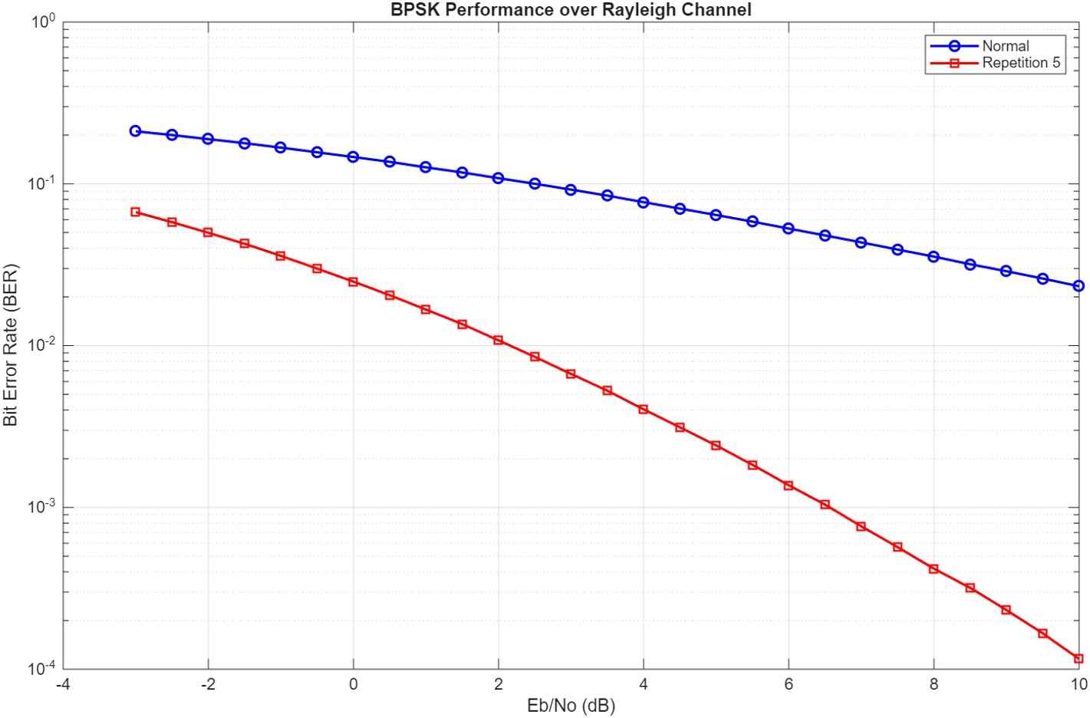
BPSK BER Over Rayleigh Channel
The BER for repetition-5 is significantly better than that of normal bpsk.
In this case, an error occurs only if three or more bits are changed, which is much less likely than a single-bit error in normal bpsk.
BPSK BER Over Rayleigh Channel

Slide 9
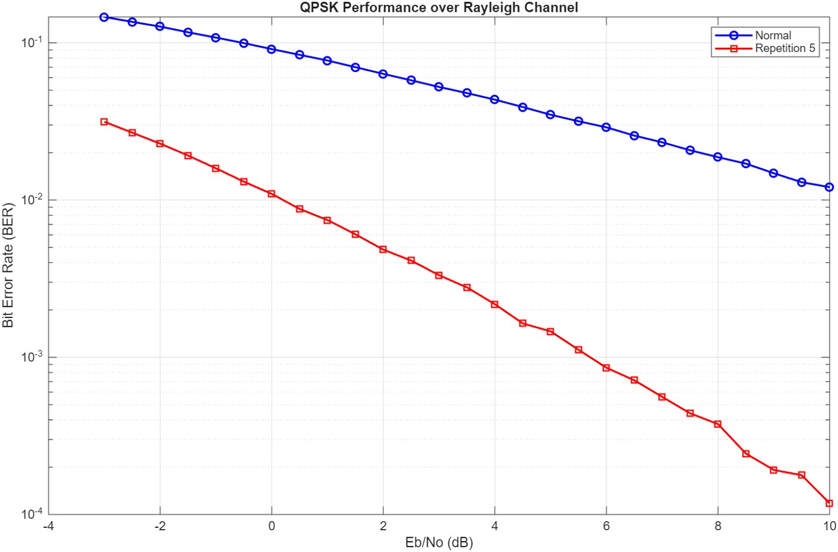
QPSK BER over Rayleigh Channel
The next curve shows the performance comparison between normal QPSK and repetition-5 QPSK. As expected, QPSK with repetition-5 demonstrates better performance.
Comparing BPSK and QPSK BER over rayleigh channel, we can see that the difference in BER between the two cases is relatively small.
QPSK BER Over Rayleigh Channel

Slide 10
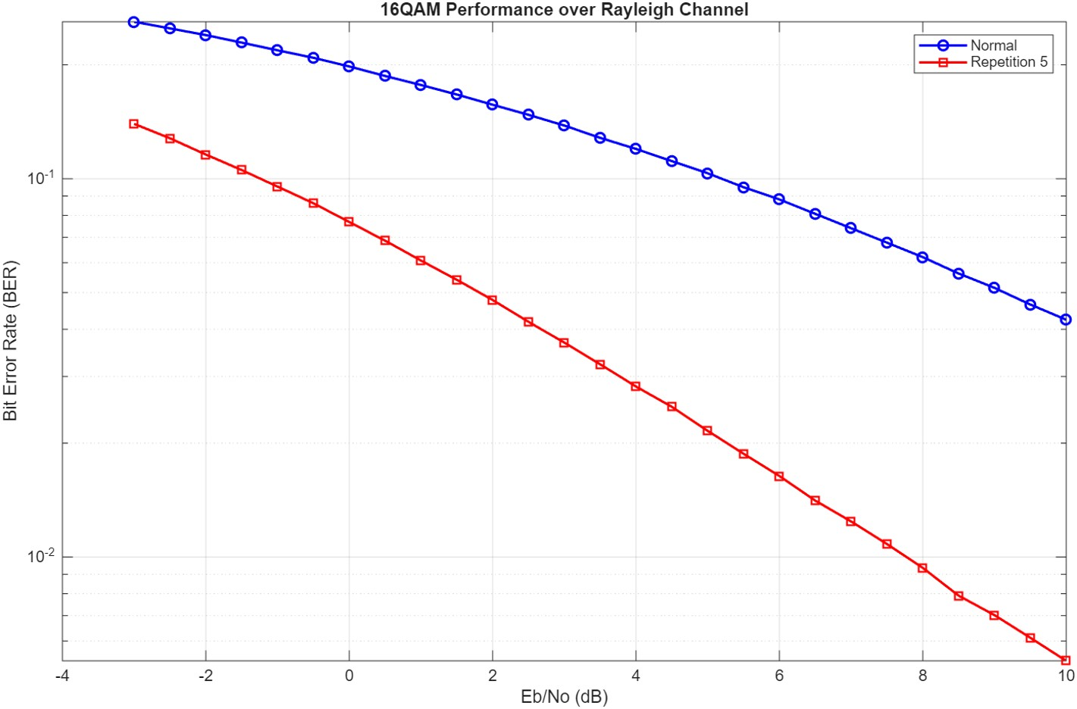
16-QAM BER over Rayleigh Channel
As the modulation order increases, the BER also increases. This occurs because higher-order constellations have more symbols, which reduces the distance between points and tightens the decision boundaries, making the system more sensitive to noise.
On the other hand, higher-order modulation provides a higher data rate. For example, 16-QAM transmits at four times the rate of BPSK and twice the rate of QPSK.
16-QAM BER Over Rayleigh Channel

Slide 11
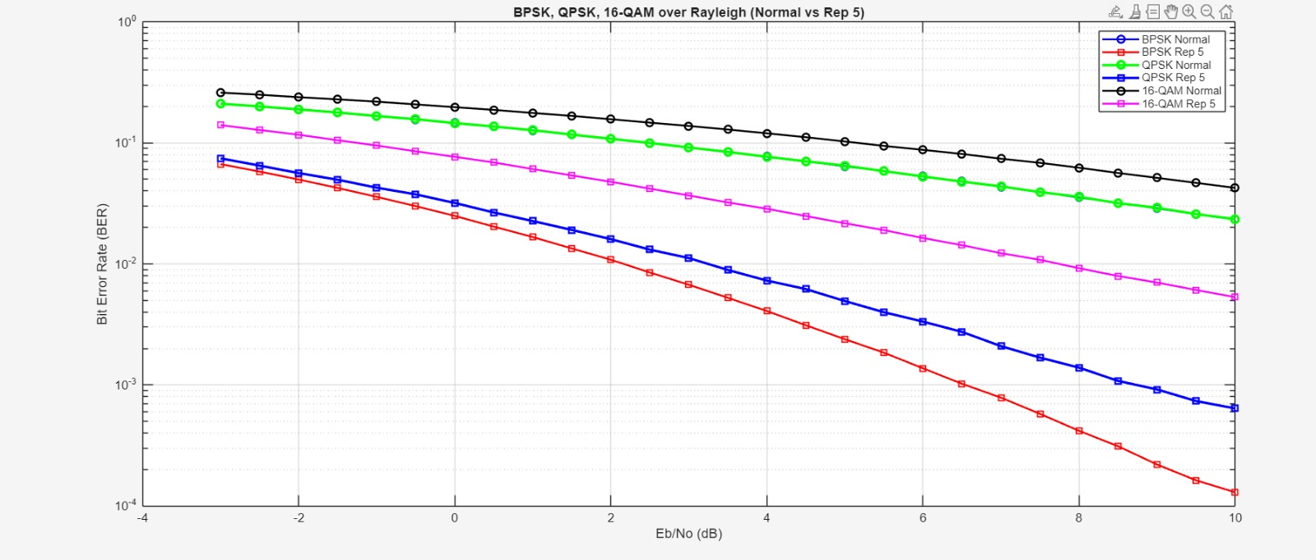
BPSK,QPSK and 16-QAM BER Over Rayleigh Channel
The BER performance of BPSK and QPSK is almost identical; however, QPSK is preferred due to its higher data rate. On the other hand, 16-QAM exhibits the worst BER performance, but it provides a higher data rate than both BPSK and QPSK.
The BPSK and QPSK repetition 5 curves are not the same.
BPSK,QPSK and 16-QAM BER Over Rayleigh Channel

Slide 12
Code
Bitstream Generation:
% Set number of bits based on modulation switch upper(modulation_type) case 'BPSK' Num_bits = 5e6; bits_per_symbol = 1; case 'QPSK' Num_bits = 5e5; bits_per_symbol = 2; case '16QAM' Num_bits = 1.2e6; bits_per_symbol = 4; otherwise error('Unsupported modulation type'); end fprintf('Running %s simulation with repetition factor = %d...\n', modulation_type, repetition_factor); % Generate original bits (column vector) Tx_bits = randi([0 1], Num_bits, 1);

Slide 13
Code - Transmitter
Repetition Encodin:
function bits_rep = encode_bits(bits, repetition_factor) % Repeat each bit 'repetition_factor' times bits_rep = repelem(bits, repetition_factor); end
Modulation:
function symbols = map_bits(bits, modulation) % Maps bits to symbols based on modulation switch upper(modulation) case 'BPSK' symbols = 2*bits - 1; % 0->-1, 1->1 case 'QPSK' b1 = bits(1:2:end-1); b2 = bits(2:2:end); symbols = complex(2*b1-1, 2*b2-1); case '16QAM' % 16-QAM Gray Mapping bits = bits(:); b = reshape(bits,4,[]).’; gray = zeros(size(b)); gray(:,1) = b(:,1); gray(:,2) = xor(b(:,1),b(:,2)); gray(:,3) = xor(b(:,2),b(:,3));

Slide 14
Code - Transmitter
Modulation:
gray(:,4) = xor(b(:,3),b(:,4)); idx = bi2de(gray,'left-msb')+1; % 16-QAM constellation (normalized) I_levels = [-3 -1 3 1]; Q_levels = [-3 -1 3 1]; const = zeros(16,1); for k=0:15 bin_k = de2bi(k,4,'left-msb'); bin_nat = zeros(size(bin_k)); bin_nat(1) = bin_k(1); bin_nat(2) = xor(bin_nat(1), bin_k(2)); bin_nat(3) = xor(bin_nat(2), bin_k(3)); bin_nat(4) = xor(bin_nat(3), bin_k(4)); i_idx = bi2de(bin_nat(1:2),'left-msb')+1; q_idx = bi2de(bin_nat(3:4),'left-msb')+1; const(k+1) = I_levels(i_idx)+1j*Q_levels(q_idx); end const = const/sqrt(mean(abs(const).^2)); symbols = const(idx).'; otherwise error('Unsupported modulation type'); end end

Slide 15
Code - Transmitter
Rayleigh Channel Implementation:
function [rx, h] = rayleigh_channel(tx, N0) tx = tx(:); % ensure column vector h = (randn(length(tx),1) + 1j*randn(length(tx),1))/sqrt(2); % Rayleigh n = sqrt(N0/2)*(randn(length(tx),1) + 1j*randn(length(tx),1)); % AWGN rx = h .* tx + n; end
Receiver Processing:
function z = equalize(rx,h) % Channel equalization z = rx ./ h; end

Slide 16
Code - Transmitter
Demapping:
function bits_dec = decode_bits(bits_rx, repetition_factor) % Majority vote decoding bits_matrix = reshape(bits_rx, repetition_factor, []); bits_dec = sum(bits_matrix,1) >= ceil(repetition_factor/2); bits_dec = bits_dec.'; % column vector end
Decoding:
function bits = demap_symbols(symbols, modulation) % Demap symbols back to bits switch upper(modulation) case 'BPSK' bits = real(symbols) >= 0; case 'QPSK' bits = zeros(2*length(symbols),1); bits(1:2:end-1) = real(symbols)>=0; bits(2:2:end) = imag(symbols)>=0;

Slide 17
Code - Transmitter
Decoding:
case '16QAM' symbols = symbols(:); % ensure column vector % Define constellation I_levels = [-3 -1 3 1]; Q_levels = [-3 -1 3 1]; const = zeros(16,1); for k=0:15 bin_k = de2bi(k,4,'left-msb'); bin_nat = zeros(size(bin_k)); bin_nat(1) = bin_k(1); bin_nat(2) = xor(bin_nat(1), bin_k(2)); bin_nat(3) = xor(bin_nat(2), bin_k(3)); bin_nat(4) = xor(bin_nat(3), bin_k(4)); i_idx = bi2de(bin_nat(1:2),'left-msb')+1; q_idx = bi2de(bin_nat(3:4),'left-msb')+1; const(k+1) = I_levels(i_idx)+1j*Q_levels(q_idx); end const = const/sqrt(mean(abs(const).^2)); % Nearest neighbor detection [~, idx] = min(abs(symbols - const.'),[],2); % now safe gray = de2bi(idx-1,4,'left-msb');

Slide 18
Code - Transmitter
Decoding:
% Reverse Gray bits_mat = zeros(size(gray)); bits_mat(:,1) = gray(:,1); bits_mat(:,2) = xor(bits_mat(:,1),gray(:,2)); bits_mat(:,3) = xor(bits_mat(:,2),gray(:,3)); bits_mat(:,4) = xor(bits_mat(:,3),gray(:,4)); bits = reshape(bits_mat.',[],1); otherwise error('Unsupported modulation type'); end end
BER Compution:
function BER = compute_ber(tx,rx) % Compute Bit Error Rate BER = sum(tx~=rx)/length(tx); end

Slide 19
Code - Transmitter
BER Simulation over SNR:
for idx = 1:length(SNR_db) %% ----- Noise power ----- EbNo_linear = 10^(SNR_db(idx)/10); N0 = Eb / (EbNo_linear * bits_per_symbol); %% ----- BER without repetition (Normal) ----- tx_symbols_normal = map_bits(Tx_bits, modulation_type); [rx_symbols_normal, h_normal] = rayleigh_channel(tx_symbols_normal, N0); z_normal = equalize(rx_symbols_normal, h_normal); rx_bits_normal = demap_symbols(z_normal, modulation_type); BER_Normal(idx) = compute_ber(Tx_bits, rx_bits_normal); %% ----- BER with repetition (factor 5) ----- Tx_bits_rep = encode_bits(Tx_bits, repetition_factor); tx_symbols_rep = map_bits(Tx_bits_rep, modulation_type); [rx_symbols_rep, h_rep] = rayleigh_channel(tx_symbols_rep, N0); z_rep = equalize(rx_symbols_rep, h_rep); rx_bits_rep = demap_symbols(z_rep, modulation_type); Rx_bits = decode_bits(rx_bits_rep, repetition_factor); BER_Rep5(idx) = compute_ber(Tx_bits, Rx_bits); end

Slide 20
Code - Transmitter
Result Visualization:
% PART 3: Plot Results figure; semilogy(SNR_db, BER_Normal, 'b-o','LineWidth',1.5); hold on; semilogy(SNR_db, BER_Rep5, 'r-s','LineWidth',1.5); grid on; xlabel('Eb/No (dB)'); ylabel('Bit Error Rate (BER)'); legend('Normal','Repetition 5'); title(sprintf('%s Performance over Rayleigh Channel', modulation_type));

Slide 21
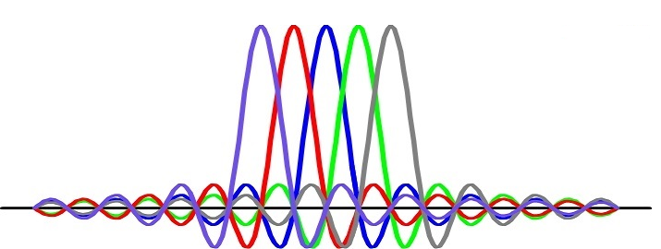
OFDM System Simulation

Slide 22
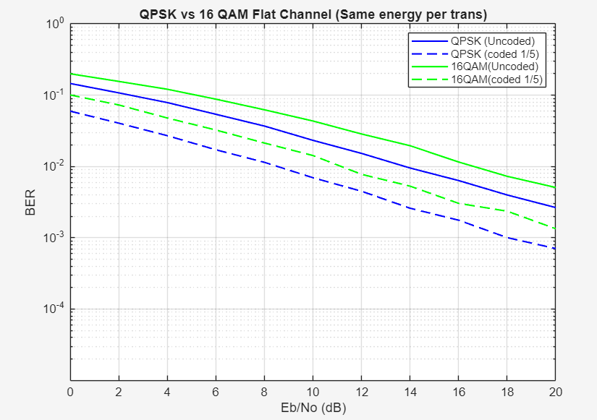
Flat Fading Channel
QPSK achieves lower BER than 16-QAM due to its larger constellation distance
Effect of Coding (Repetition 1/5):
Fading affects all subcarriers simultaneously.
All 5 copies suffer the exact same fade. This results in the inability to exploit the multi carrier advantages
The improvement seen in is purely due to energy of the repetition code

Slide 23
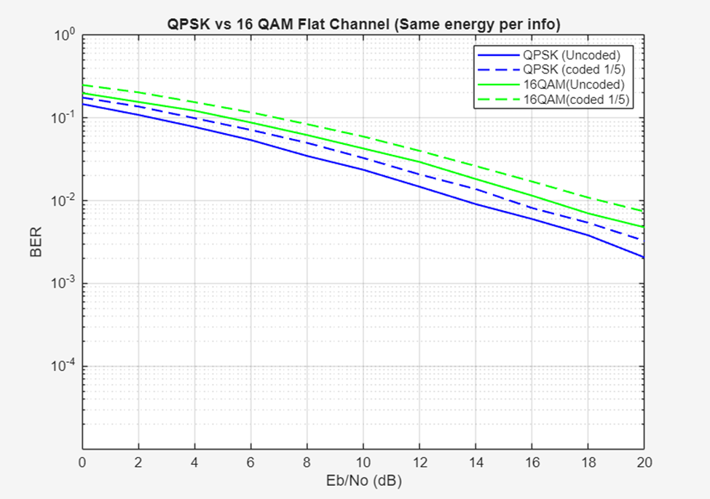
Flat Fading Channel
Same energy per information bit
Same energy per transmission bit

Slide 24
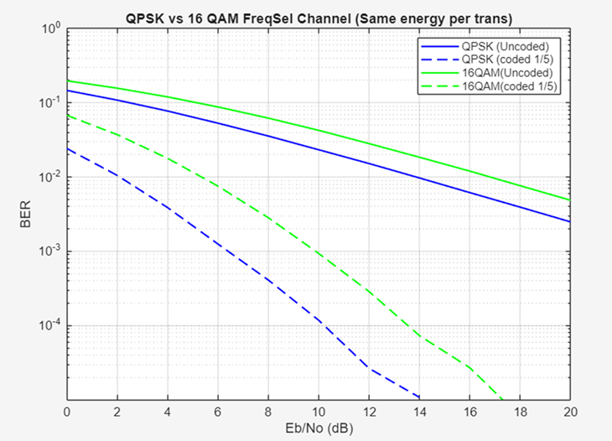
Frequency Selective Fading Channel
QPSK achieves lower BER than 16-QAM due to its larger constellation distance
Effect of Coding (Repetition 1/5):
Fading on different subcarriers is independent
System is exploiting the multi carrier advantages.
Repetition code spreads the 5 copies of a bit across different subcarriers.
The probability of 3 of 5 subcarriers being in a deep fade simultaneously is low.
Some improvement is due to energy of the repetition code

Slide 25
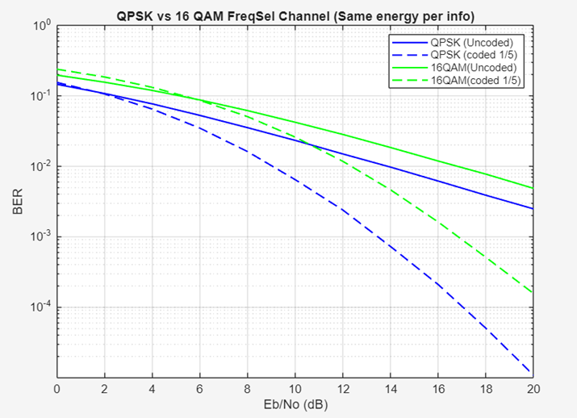
Frequency Selective Fading Channel
Same energy per information bit
Same energy per transmission bit

Slide 26
Code
Parameters:
% ===================== System Parameters ===================== cp = 16; % Cyclic prefix length rate = 1/5; % Coding rate N_fft = 256; % FFT size Eb_N0_dB = 0:2:20; % Eb/N0 range in dB N_OFDM = 10000; % Number of OFDM symbols modulation ='QPSK'; % Modulation type: (BPSK, QPSK, 16QAM) energy_type = 'Same_Per_Trans'; % Energy normalization type channel_type = 'FreqSel'; % Channel type: Flat or Frequency Selective

Slide 27
Code - Transmitter
Bitstream Generation:
function R = generate_data(m, N_fft, N_code) % N_code = 1 mean No coding it applied R = randi([0 1], 1, floor(N_fft/N_code)*m); End
Encoder:
function R = Encoder(data, m, N_fft, N_code) % N_code = 1 mean No coding it applied encoded_data = repelem(data, N_code); % Padding R = [encoded_data, zeros(1, (m*N_fft)-length(encoded_data))]; End

Slide 28
Code - Transmitter
Interleaver:
function R = Interleaver(mod, data) if isequal(mod, 'BPSK') reshape_tx_data = reshape(data, 8, 32)'; elseif isequal(mod, 'QPSK') reshape_tx_data = reshape(data, 16, 32)'; elseif isequal(mod, '16QAM') reshape_tx_data = reshape(data, 32, 32)'; end R = reshape_tx_data(:)'; end

Slide 29
Code - Transmitter
Mapper, ifft and cyclic extension:
% Mapper mapper_output = Mapper(interleaver_output, modulation); % ifft ifft_output = ifft(mapper_output, N_fft); % cyclic extension cyclic_output = [ifft_output(end-cp+1:end), ifft_output];

Slide 30
Code - Channel
Channel
function [Channel_Output, H] = Channel(data, m, Eb_N0_dB, N_code, N_fft, cp, channeltype, energy_type) % Noise segma = sqrt((1/2)./10^(Eb_N0_dB/10)); Eb_actual = (sum(abs(data).^2)/length(data))/m; noise = sqrt(Eb_actual) * segma * (randn(size(data)) + 1j*randn(size(data))); if isequal(energy_type, 'Same_Per_Info') noise = sqrt(N_code) * noise; end if isequal(channeltype, 'Flat') % Flat fading channel H = sqrt(1/2)*(randn(1) + 1j*randn(1)); Channel_Output = H*data + noise; else

Slide 31
Code - Channel
% Frequency selective channel H = sqrt(1/2)*(randn(1, N_fft) + 1j*randn(1, N_fft)); % Remove cyclic extension data_cp_removed = data(cp+1:end); % Frequency domain data_freq = fft(data_cp_removed, N_fft); % Applay Freqency Selctive Channel ch_out_freq = data_freq .* H; % Time domain ch_out = ifft(ch_out_freq, N_fft); % Add cyclic extension ch_out = [ch_out(end-cp+1:end), ch_out]; %Add Noise Channel_Output = ch_out + noise; end end

Slide 32
Code - Receiver
Remove cyclic extension, fft, channel equlization:
% Remove cyclic extension remove_cyclic_output = channel_output(cp+1:end); % fft fft_output = fft(remove_cyclic_output, N_fft); % channel equalization channel_equ = fft_output ./ H;

Slide 33
Code - Receiver
De-Mapper, De-Interleaver and Decoder:
% De-Mapper demapper_output = Demapper(channel_equ, modulation); % De-Interleaver deinterleaver_output = DeInterleaver(modulation, demapper_output); % Decoder decoder_output = Decoder(deinterleaver_output, m, N_fft, N_code);

Slide 34
Thank you
Team 46

